Slide 1
Compile and Run a Program
Mr. Neat
Java

Slide 2
Let’s Try Our First
Program
Go into the “compile run example”
folder
Double click on the file labeled “C”
Note a new file appears with the
extension .class
Double click on the file labeled “R”
Note a window appears. This window
shows the output of the program

Slide 3
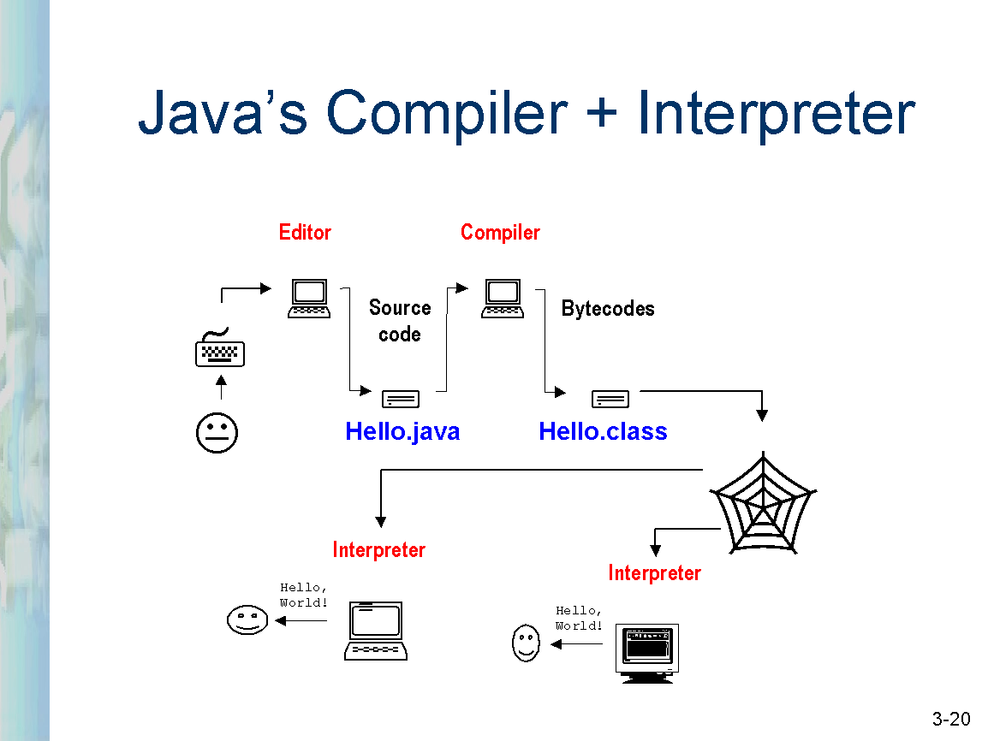

Slide 4
} C.BAT
} R.BAT

